Slide 1
Web Page Classification
Feature and Algorithms
Xiaoguang Qi and Brian D. Davison
Department of Computer Science & Engineering
Lehigh University, June 2007
Presented by
Mr.Pachara Chutisawaeng
Department of Computer Science
Mahidol University, July 2009

Slide 2
Agenda
Webpage classification significance
Introduction
Background
Applications of web classification
Features
Algorithms
Blog Classification
Conclusion

Slide 3
Webpage classification significance
Presented by
Mr.Pachara Chutisawaeng
Department of Computer Science
Mahidol University, July 2009

Slide 4
Webpage classification significance
Let’s go back in history about 10 years.
The Evolution of Websites: How 5 popular Websites have changed

Slide 5

Apple - present

Slide 6
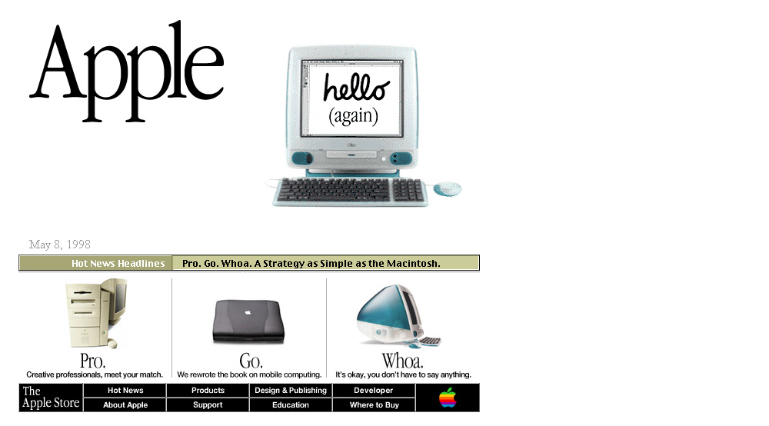
Apple – 10 Years ago!

Slide 7

Amazon - present

Slide 8
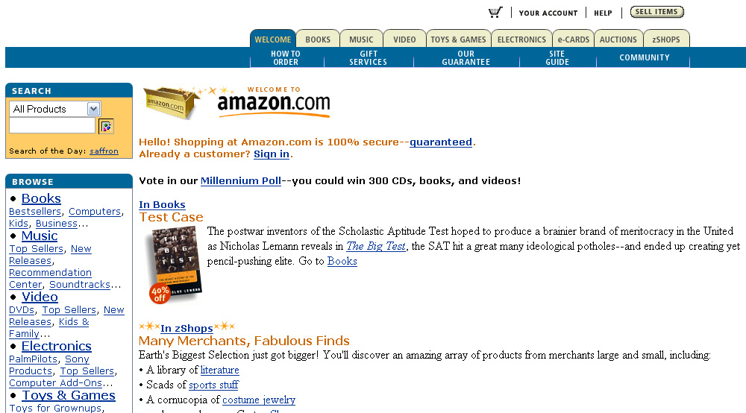
Amazon – 9 Years ago

Slide 9
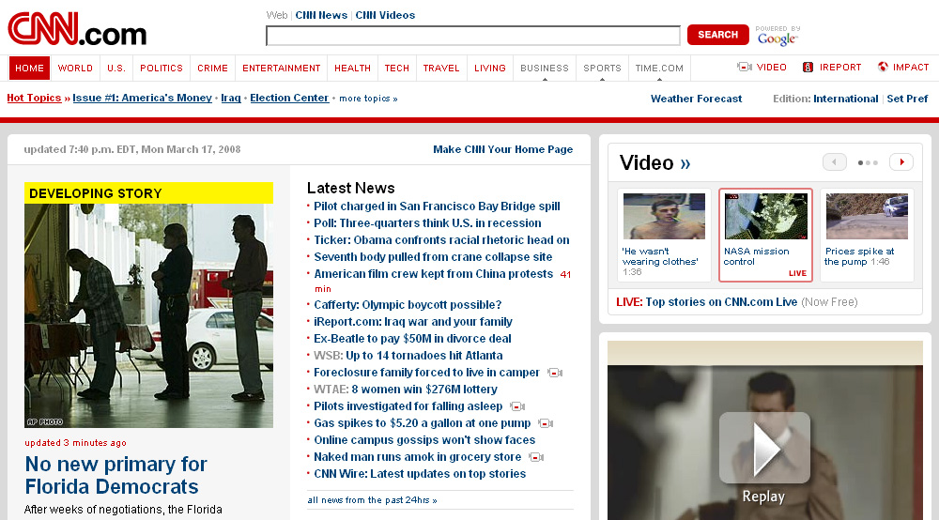
CNN - present

Slide 10
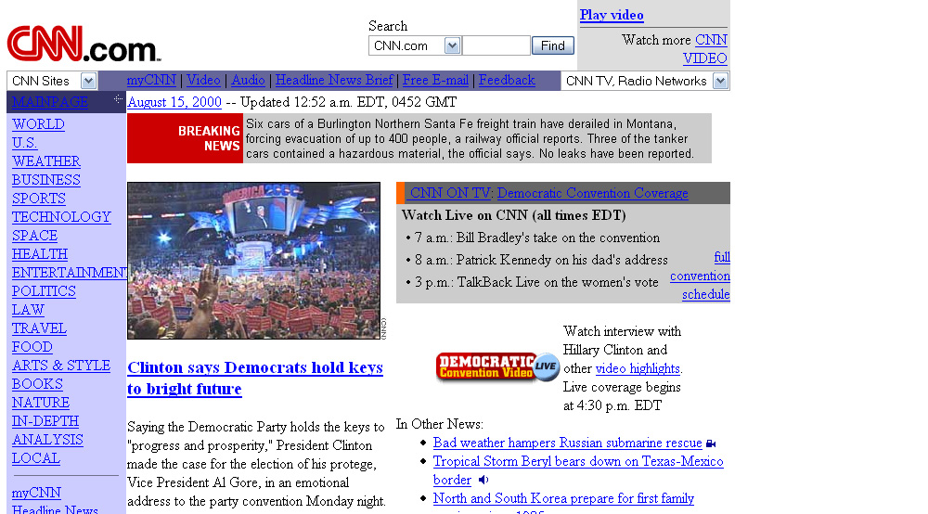
CNN – 8 Years ago

Slide 11

Yahoo! - present

Slide 12
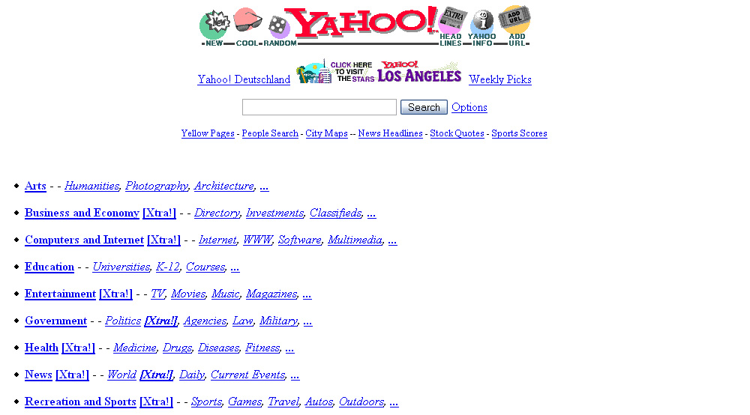
Yahoo! – 12 Years ago

Slide 13
Webpage classification significance
What’s different between past and present what changed?

Slide 14

Nike - present

Slide 15

Nike – 8 Years ago

Slide 16
Webpage classification significance
What’s different between past and present what changed?
Flash animation
Java Script
Video Clips, Embedded Object
Advertise, GG Ad sense, Yahoo!

Slide 17
Introduction
Presented by
Mr.Pachara Chutisawaeng
Department of Computer Science
Mahidol University, July 2009

Slide 18
Introduction
Webpage classification or webpage categorization is the process of assigning a webpage to one or more category labels. E.g. “News”, “Sport” , “Business”
GOAL: They observe the existing of web classification techniques to find new area for research. Including web-specific features and algorithms that have been found to be useful for webpage classification.

Slide 19
Introduction
What will you learn?
A Detailed review of useful features for web classification
The algorithms used
The future research directions
Webpage classification can help improve the quality of web search.
Knowing is thing help you to improve your SEO skill.
Each search engine, keep their technique in secret.

Slide 20
Background
Presented by
Mr.Pachara Chutisawaeng
Department of Computer Science
Mahidol University, July 2009

Slide 21
Background
The general problem of webpage classification can be divided into
Subject classification; subject or topic of webpage e.g. “Adult”, “Sport”, “Business”.
Function classification; the role that the webpage play e.g. “Personal homepage”, “Course page”, “Admission page”.

Slide 22
Background
Based on the number of classes in webpage classification can be divided into
binary classification
multi-class classification
Based on the number of classes that can be assigned to an instance, classification can be divided into single-label classification and multi-label classification.

Slide 23
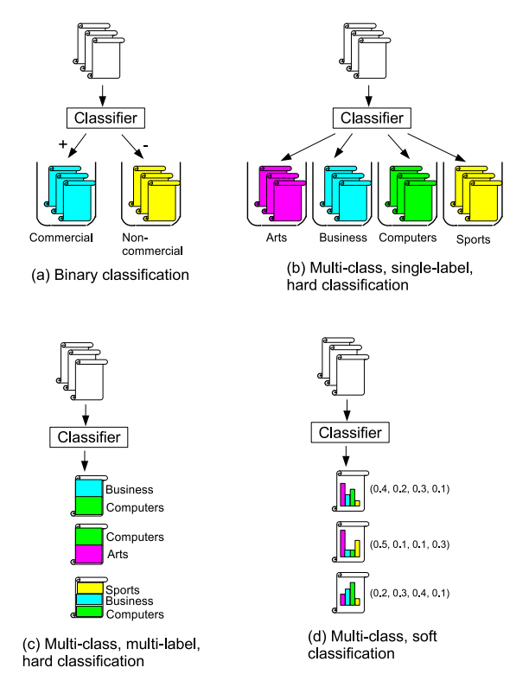
Types of classification

Slide 24
Applications of web classification
Presented by
Mr.Pachara Chutisawaeng
Department of Computer Science
Mahidol University, July 2009

Slide 25
Applications of web classification
Constructing and expanding web directories (web hierarchies)
Yahoo !
ODP or “Open Dictionary Project”
http://www.dmoz.org
How are they doing?

Slide 26
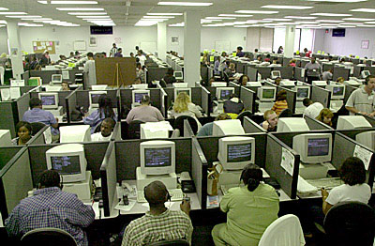
Keyworder

Slide 27
Applications of web classification
How are they doing?
By human effort
July 2006, it was reported there are 73,354 editor in the dmoz ODP.
As the web changes and continue to grow so “Automatic creation of classifiers from web corpora based on use-defined hierarchies” has been introduced by Huang et al. in 2004
The starting point of this presentation !!

Slide 28
Applications of web classification
Improving quality of search results
Categories view
Ranking view

Slide 29

Categories and Ranking View

Slide 30
Applications of web classification
Improving quality of search results
Categories view
Ranking view
In 1998, Page and Brin developed the link-based ranking algorithm called PageRank
Calculates the hyperlinks with our considering the topic of each page

Slide 31
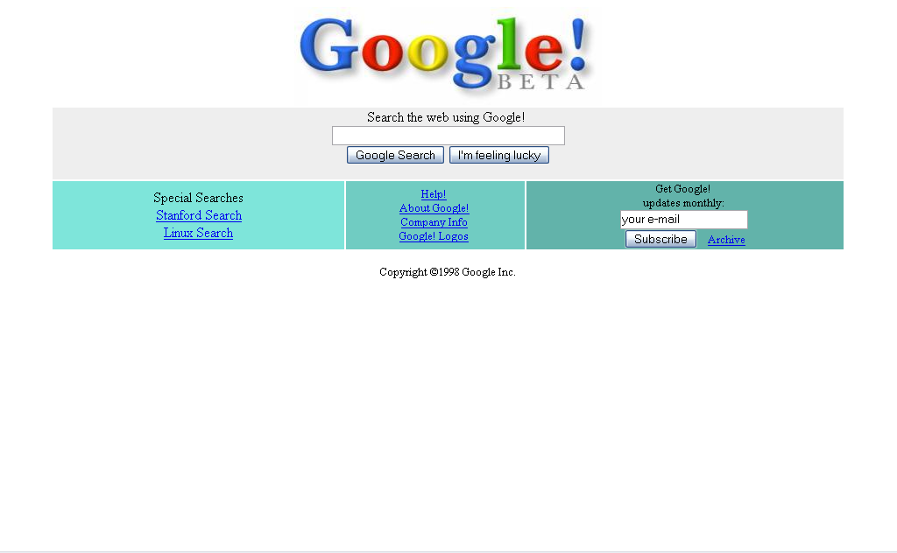
Google – 11 Years ago

Slide 32
Applications of web classification
Helping question answering systems
Yang and Chua 2004
suggest finding answers to list questions e.g. “name all the countries in Europe”
How it worked?
Formulated the queries and sent to search engines.
Classified the results into four categories
Collection pages (contain list of items)
Topic pages (represent the answers instance)
Relevant page (Supporting the answers instance)
Irrelevant pages
After that , topic pages are clustered, from which answers are extracted.
Answering question system could benefit from web classification of both accuracy and efficiency

Slide 33
Applications of web classification
Other applications
Web content filtering
Assisted web browsing
Knowledge base construction

Slide 34
Features
Presented by
Mr.Pachara Chutisawaeng
Department of Computer Science
Mahidol University, July 2009

Slide 35
Features
In this section, we review the types of features that useful in webpage classification research.
The most important criteria in webpage classification that make webpage classification different from plaintext classification is HYPERLINK <a>…</a>
We classify features into
On-page feature: Directly located on the page
Neighbors feature: Found on the pages related to the page to be classified.

Slide 36
Features: On-page
Presented by
Mr.Pachara Chutisawaeng
Department of Computer Science
Mahidol University, July 2009

Slide 37
Features: On-page
Textual content and tags
N-gram feature
Imagine of two different documents. One contains phrase “New York”. The other contains the terms “New” and “York”. (2-gram feature).
In Yahoo!, They used 5-grams feature.
HTML tags or DOM
Title, Headings, Metadata and Main text
Assigned each of them an arbitrary weight.
Now a day most of website using Nested list (<ul><li>) which really help in web page classification.

Slide 38
Features: On-page
Textual content and tags
URL
Kan and Thi 2004
Demonstrated that a webpage can be classified based on its URL

Slide 39
Features: On-page
Visual analysis
Each webpage has two representations
Text which represent in HTML
The visual representation rendered by a web browser
Most approaches focus on the text while ignoring the visual information which is useful as well
Kovacevic et al. 2004
Each webpage is represented as a hierarchical “Visual adjacency multi graph.”
In graph each node represents an HTML object and each edge represents the spatial relation in the visual representation.

Slide 40
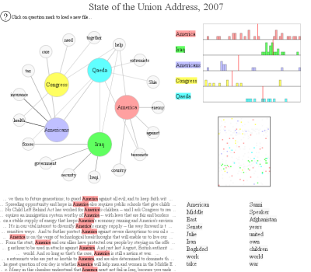
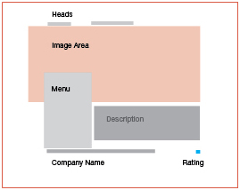
Visual analysis

Slide 41
Features: Neighbors Features
Presented by
Mr.Pachara Chutisawaeng
Department of Computer Science
Mahidol University, July 2009

Slide 42
Features: Neighbors Features
Motivation
The useful features that we discuss previously, in a particular these features are missing or unrecognizable

Slide 43

Example webpage which has few useful on-page features

Slide 44
Features: Neighbors features
Underlying Assumptions
When exploring the features of neighbors, some assumptions are implicitly made in existing work.
The presence of many “sports” pages in the neighborhood of P-a increases the probability of P-a being in “Sport”.
Chakrabari et al. 2002 and Meczer 2005 showed that linked pages were more likely to have terms in common .
Neighbor selection
Existing research mainly focuses on page with in two steps of the page to be classified. At the distance no greater than two.
There are six types of neighboring pages: parent, child, sibling, spouse, grandparent and grandchild.

Slide 45
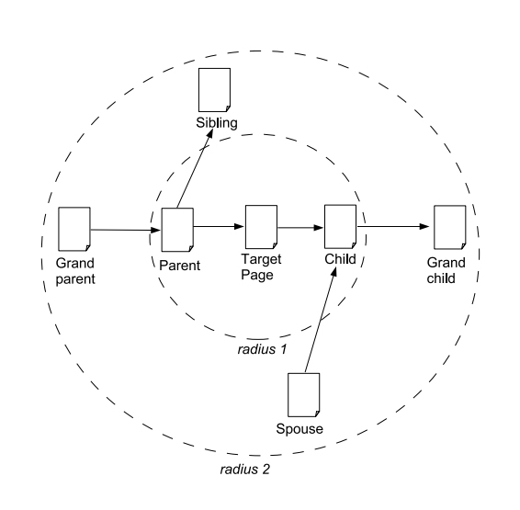
Neighbors with in radius of two

Slide 46
Features: Neighbors features
Neighbor selection cont.
Furnkranz 1999
The text on the parent pages surrounding the link is used to train a classifier instead of text on the target page.
A Target page will be assigned multiple labels. These label are then combine by some voting scheme to form the final prediction of the target page’s class
Sun et al. 2002
Using the text on the target page. Using page title and anchor text from parent pages can improve classification compared a pure text classifier.

Slide 47
Features: Neighbors features
Neighbor selection cont.
Summary
Using parent, child, sibling and spouse pages are all useful in classification, siblings are found to be the best source.
Using information from neighboring pages may introduce extra noise, should be use carefully.

Slide 48
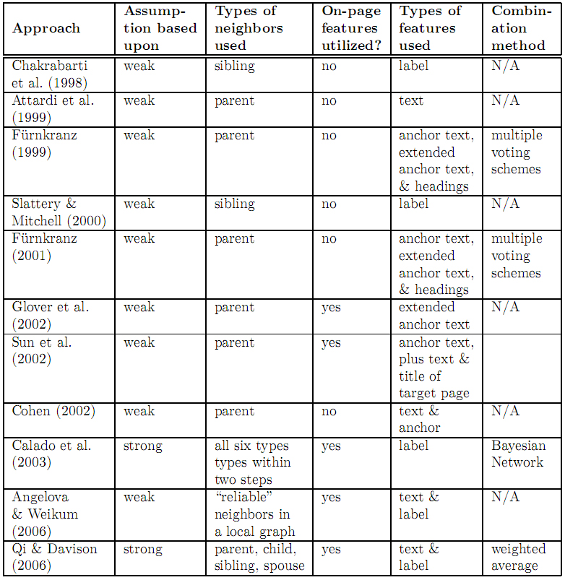

Slide 49
Features: Neighbors features
Features
Label : by editor or keyworder
Partial content : anchor text, the surrounding text of anchor text, titles, headers
Full content
Among the three types of features, using the full content of neighboring pages is the most expensive however it generate better accuracy.

Slide 50
Features: Neighbors features
Utilizing artificial links (implicit link)
The hyperlinks are not the only one choice.
What is implicit link?
Connections between pages that appear in the results of the same query and are both clicked by users.
Implicit link can help webpage classification as well as hyperlinks.

Slide 51
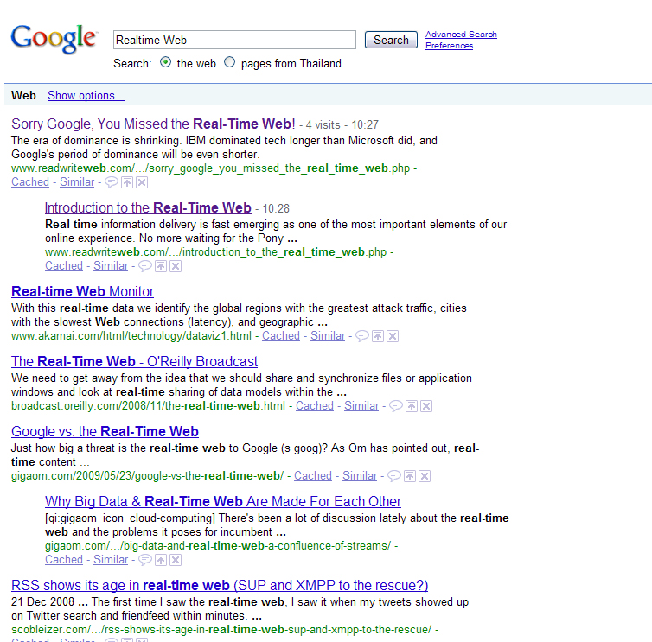

Slide 52
Discussion: Features
However, since the results of different approaches are based on different implementations and different datasets, making it difficult to compare their performance.
Sibling page are even more use full than parents and children.
This approach may lie in the process of hyperlink creation.
But a page often acts as a bridge to connect its outgoing links, which are likely to have common topic.

Slide 53
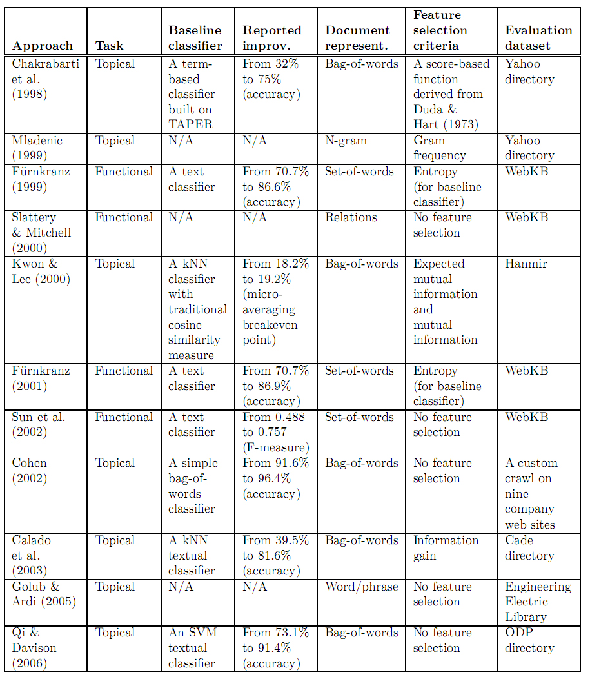

Slide 54
Tip! Tracking Incoming Link How to know when someone link to you?
Presented by
Mr.Pachara Chutisawaeng
Department of Computer Science
Mahidol University, July 2009

Slide 55
Algorithms
Presented by
Mr.Pachara Chutisawaeng
Department of Computer Science
Mahidol University, July 2009

Slide 56
Algorithm Approaches for Webpage Classification
Algorithms
Dimension reduction
Relational learning
Modifications to traditional algorithms
Hierarchical classification
Combining information from multiple sources

Slide 57
Dimension Reduction
Feature weighting
Another important role for webpage classification
Way of boosting the classification by emphasizing the features with the better discriminative power
Special case of weighing: “Feature Selection”

Slide 58
Dimension Reduction (cont’d) : Feature Selection
A special case of “feature weighting”
‘Zero weight’ is assigned to the eliminated features
The role:
Reduce the dimensionality of the feature space
Computational complexity reduction
Classification can be more accurate in the reduced space

Slide 59
Dimension Reduction (con) : Feature Selection
Simple approaches
First fragment of each document
First fragment to the web documents in hierarchical classification
Text categorization approaches
Information gain
Mutual information
Etc.

Slide 60
Feature Selection (Cont’d) : Simple measure
Using the first fragment of each documents
Assumption: a summary is at beginning of the document
Fast and accurate classification for news articles
Not satisfying for other types of documents
First fragment applied to Hierarchical classification of web pages
Useful for web documents

Slide 61
Feature Selection (Cont’d) : Text Categorization Measures
Using expected mutual information and mutual information
Two well-known metrics based on variation of the k-Nearest Neighbor algorithm
Weighted terms according to its appearing HTML tags
Terms within different tags handle different importance
Using information gain
Another well-known metric
Still not apparently show which one is more superior for web classification

Slide 62
Feature Selection (Cont’d) : Text Categorization Measures
Approving the performance of SVM classifiers
By aggressive feature selection
Developed a measure with the ability to predict the selection effectiveness without training and testing classifiers
A popular Latent Semantic Indexing (LSI)
In Text documents:
Docs are reinterpreted into a smaller transformed, but less intuitive space
Cons: high computational complexity makes it inefficient to scale
in Web classification
Experiments based on small datasets (to avoid the above ‘cons’)
Some work has approved to make it applicable for larger datasets which still needs further study

Slide 63
Algorithm Approaches for Webpage Classification
Algorithms
Dimension reduction
Relational learning
Modifications to traditional algorithms
Hierarchical classification
Combining information from multiple sources

Slide 64
Relational Learning
Webpage: instances with the HYPERLINK RELATION connection
Webpage classification: a relational learning problem
Hence, relational learning algorithms are used with the webpage classification

Slide 65
Relational Learning (cont’d) : 2 Main Approaches
Relaxation Labeling Algorithms
Original proposal:
Image analysis
Current usage:
Image and vision analysis
Artificial Intelligence
pattern recognition
web-mining
Link-based Classification Algorithms
Utilizing 2 popular link-based algorithms
Loopy belief propagation
Iterative classification

Slide 66
Relational Learning (cont’d) : Relaxation Labeling Algorithms
Flow of the algorithm
text classifier
Nodes with their assigned class probabilities
Same process to each node’s neighbors
Nodes considered in turn
Nodes’ probabilities reevaluated taking into account the latest estimates of the neighbors’

Slide 67
Relaxation Labeling (cont’d) : Algorithm variations
Using a combined logistic classifier
based on content and link information
Shows improvement over a textual classifier
Outperforms a single flat classifier based on both content and link features
Selecting the proper Neighbors ONLY
Not all neighbors are qualified
The chosen neighbors’ option:
Similar enough in content

Slide 68
Relational Learning (cont’d) : Link-based Classification Algorithms
Two popular link-based algorithms:
Loopy belief propagation
Iterative classification
Better performance on a web collection than textual classifiers
During the scientists’ study, ‘a toolkit’ was implemented
Toolkit features
Classify the networked data which
utilized a relational classifier and a collective inference procedure
Demonstrated its great performance on several datasets including web collections

Slide 69
Algorithm Approaches for Webpage Classification
Algorithms
Dimension reduction
Relational learning
Modifications to traditional algorithms
Hierarchical classification
Combining information from multiple sources

Slide 70
Modifications to traditional algorithms
The traditional algorithms adjusted in the context of Webpage classification
k-Nearest Neighbors (kNN)
Quantify the distance between the test document and each training documents using “a dissimilarity measure”
Cosine similarity or inner product is what used by most existing kNN classifiers
Support Vector Machine (SVM)

Slide 71
Modification Algorithms (Cont’d) : k-Nearest Neighbors Algorithm
Varieties of modifications:
Using the term co-occurrence in document
Using probability computation
Using “co-training”

Slide 72
k-Nearest Neighbors Algorithm(Cont’d) : Modification Varieties
Using the term co-occurrence in documents
An improved similarity measure
The more co-occurred terms two documents have in common, the stronger the relationship between them
Better performance over the normal kNN (cosine similarity and inner product measures)
Using the probability computation
Condition:
The probability of a document d being in class c is determined by its distance b/w neighbors and itself and its neighbors’ probability of being in c
Simple equation
Prob. of d @ c = (distance b/w d and neighbors)(neighbors’ Prob. @ c)

Slide 73
k-Nearest Neighbors Algorithm(Cont’d) : Modification Varieties (2)
Using “Co-training”
Make use of labeled and unlabeled data
Aiming to achieve better accuracy
Scenario: Binary classification
Classifying the unlabeled instances
Two classifiers trained on different sets of features
The prediction of each one is used to train each other
Classifying only labeled instances
The co-training can cut the error rate by half
When generalized to multi-class problems
When the number of categories is large
Co-training is not satisfying
On the other hand, the method of combining error-correcting output coding (more than enough classifiers in use), with co-training can boost performance

Slide 74
Modification Algorithms (Cont’d) : SVM-based Approach
In classification, both positive and negative examples are required
SVM-Based aim:
To eliminate the need for manual collection of negative examples while still retaining similar classification accuracy

Slide 75
SVM-based Approach(Cont’d) : SVM-based Flow of algorithm
1st: Identify the most important positive features
Positive data given
Unlabeled data given
2nd: Positive Feature Filtering
Filtering out possible positive examples from unlabeled data
Leaving only negative examples (filter negative samples)
3rd: training SVM classifier
Trained on the labeled positive examples
Trained on the filtered negative examples

Slide 76
Take a Break! The Internet’s Ad Market Place Besides Google Adwords
Presented by
Mr.Pachara Chutisawaeng
Department of Computer Science
Mahidol University, July 2009

Slide 77
Algorithm Approaches for Webpage Classification
Algorithms
Dimension reduction
Relational learning
Modifications to traditional algorithms
Hierarchical classification
Combining information from multiple sources

Slide 78
Hierarchical Classification
Not so many research since most web classifications focus on the same level approaches
Approaches:
Based on “divide and conquer”
Error minimization
Topical Hierarchy
Hierarchical SVMs
Using the degree of misclassification
Hierarchical text categoriations

Slide 79
Hierarchical Classification (Cont’d) : Approaches
The use of hierarchical classification based on “divide and conquer”
Classification problems are splitted into sub-problems hierarchically
More efficient and accurate that the non-hierarchical way
Error minimization
when the lower level category is uncertain,
Minimize by shifting the assignment into the higher one
Topical Hierarchy
Classify a web page into a topical hierarchy
Update the category information as the hierarchy expands

Slide 80
Hierarchical Classification (Cont’d) : Approaches (2)
Hierarchical SVMs
Observation:
Hierarchical SVMs are more efficient than flat SVMs
None are satisfying the effectiveness for the large taxonomies
Hierarchical settings do more harm than good to kNNs and naive Bayes classifiers
Hierarchical Classification By the degree of misclassification
Opposed to measuring “correctness”
Distance are measured b/w the classifier-assigned classes and the true class.
Hierarchical text categorization
A detailed review was provided in 2005

Slide 81
Algorithm Approaches for Webpage Classification
Algorithms
Dimension reduction
Relational learning
Modifications to traditional algorithms
Hierarchical classification
Combining information from multiple sources

Slide 82
Combining Information from Multiple Sources
Different sources are utilized
Combining link and content information is quite popular
Common combination way:
Treat information from ‘different sources’ as ‘different (usually disjoint) feature sets’ on which multiple classifiers are trained
Then, the generation of FINAL decision will be made by the classifiers
Mostly has the potential to have better knowledge than any single method

Slide 83
Information Combination (Cont’d) : Approaches
Voting and Stacking
The well-developed method in machine learning
Co-Training
Effective in combining multiple sources
Since here, different classifiers are trained on disjoint feature sets

Slide 84
Information Combination (Cont’d) : Cautions
Please be noted that:
Additional resource needs sometimes cause ‘disadvantage’
The combination of 2 does NOT always BETTER than each separately

Slide 85
Blog classification
Presented by
Mr.Pachara Chutisawaeng
Department of Computer Science
Mahidol University, July 2009

Slide 86
Take a Break! Follow the Trend!! Everybody RETWEET!!
Presented by
Mr.Pachara Chutisawaeng
Department of Computer Science
Mahidol University, July 2009

Slide 87
Follow me on Twitter Follow pChr also my Blog Http://www.PacharaStudio.com
Presented by
Mr.Pachara Chutisawaeng
Department of Computer Science
Mahidol University, July 2009

Slide 88
Blog classification
The word “blog” was originally a short form of “web log”
Blogging has gained in popularity in recent years, an increasing amount of research about blog has also been conducted.
Broken into three types
Blog identification (to determine whether a web document is a blog)
Mood classification
Genre classification

Slide 89
Blog classification
Elgersma and Rijke 2006
Common classification algorithm on Blog identification using number of human-selected feature e.g. “Comments” and “Archives”
Accuracy around 90%
Mihalcea and Liu 2006 classify Blog into two polarities of moods, happiness and sadness (Mood classification)
Nowson 2006 discussed the distinction of three types of blogs (Genre Classification)
News
Commentary
Journal

Slide 90
Blog classification
Qu et al. 2006
Automatic classification of blogs into four genres
Personal diary
New
Political
Sports
Using unigram tfidf document representation and naive Bayes classification.
Qu et al.’s approach can achieve an accuracy of 84%.

Slide 91
Conclusion
Presented by
Mr.Pachara Chutisawaeng
Department of Computer Science
Mahidol University, July 2009

Slide 92
Conclusion
Webpage classification is a type of supervised learning problem that aims to categorize webpage into a set of predefined categories based on labeled training data.
They expect that future web classification efforts will certainly combine content and link information in some form.

Slide 93
Conclusion
Future work would be well-advised to
Emphasize text and labels from siblings over other types of neighbors.
Incorporate anchor text from parents.
Utilize other source of (implicit or explicit) human knowledge, such as query logs and click-through behavior, in addition to existing labels to guide classifier creation.

Slide 94
Thank you.
Presented by
Mr.Pachara Chutisawaeng
Department of Computer Science
Mahidol University, July 2009

Slide 95
Question?
Presented by
Mr.Pachara Chutisawaeng
Department of Computer Science
Mahidol University, July 2009

